Slide 1
BIG DATA
&
HADOOP
PRESENTED BY : SUDARSHAN SHARAD GAWALE

Slide 2
CONTENTS
WHAT IS BIG DATA ?
WHO GENERATES THIS BIG DATA?
INTRODUCTION TO HADOOP
WHY HADOOP IS IMPORTANT ?
HADOOP COMPONENTS , CLUSTER AND OPERATIONS
MAPREDUCE FRAMEWORK
PIG LATIN SCRIPT
CONCLUSION

Slide 3
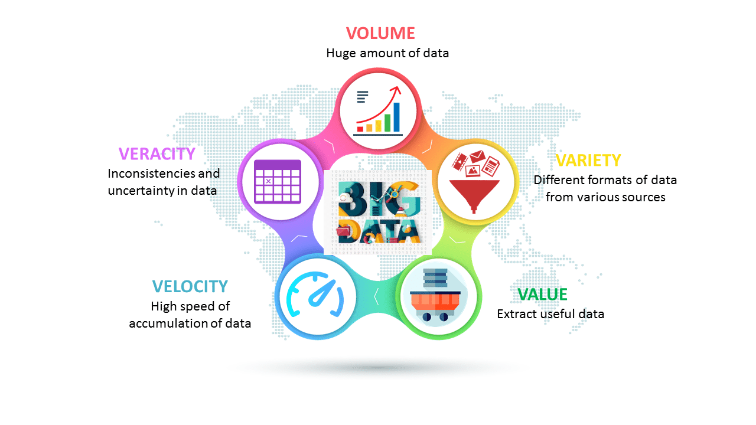
WHAT IS BIG DATA ?

Slide 4
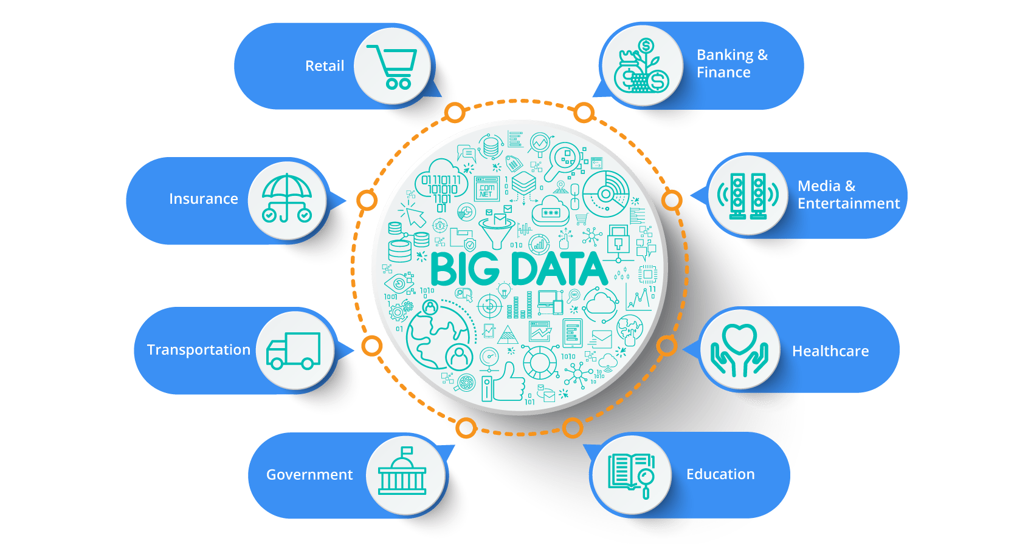
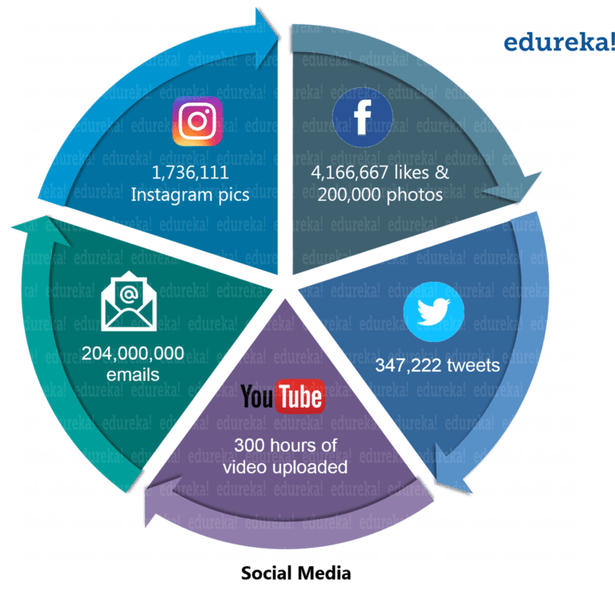
WHO GENERATES THIS BIG DATA?

Slide 5

HADOOP
Open source software framework designed for storage and processing of large scale data on clusters of commodity hardware
Created by Doug Cutting and Mike Carafella in 2005.
Cutting named the program after his son’s toy elephant.

Slide 6















WHY HADOOP IS IMPORTANT ?
WHO USES HADOOP ?

Slide 7
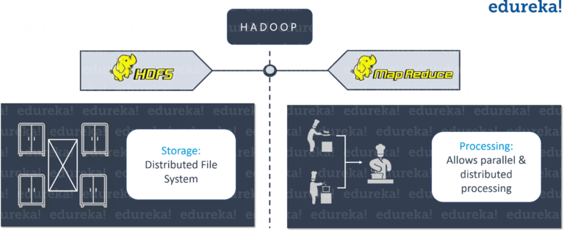
HADOOP COMPONENTS

Slide 8

HADOOP CLUSTER
NAMENODE
[ RESOURCE MANAGER ]
SECONDARY
NAMENODE
[ NODE MANAGER ]
DATANODES
FOLLOWS MASTER-SLAVE ARCHITECTURE

Slide 9
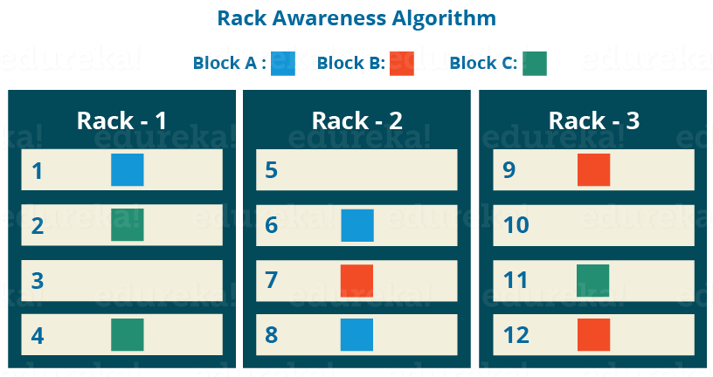
DATA REPLICATION
BY DEFAULT REPLICATION FACTOR IS 3 BUT IT IS CONFIGURABLE

Slide 10
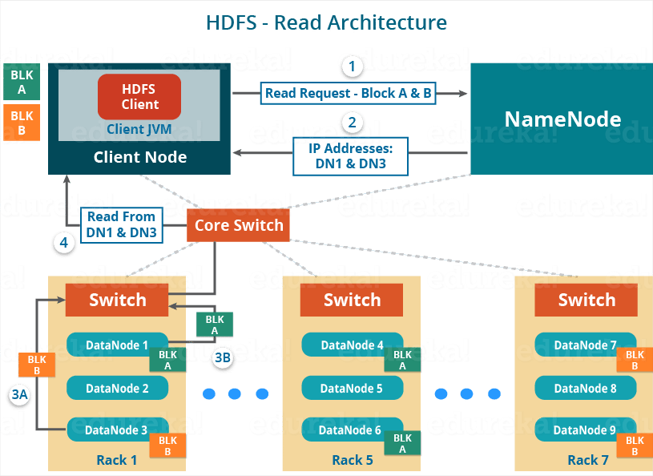
HADOOP READ OPRATION

Slide 11
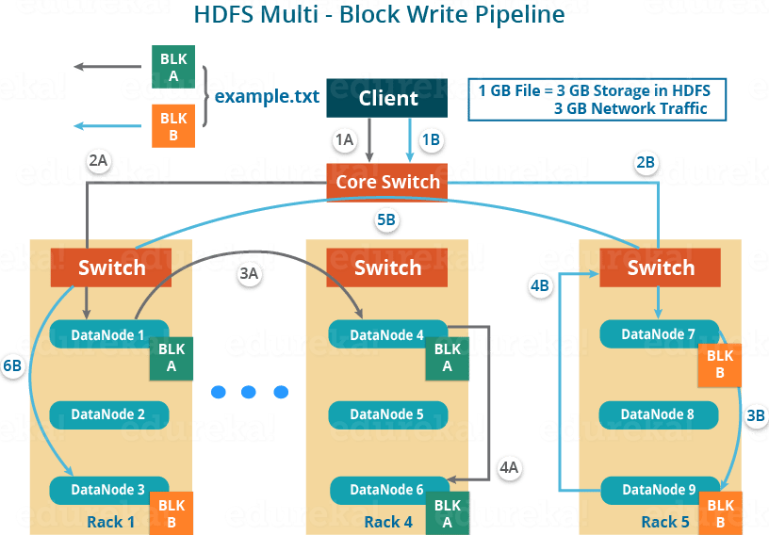
HADOOP WRITE OPERATION

Slide 12
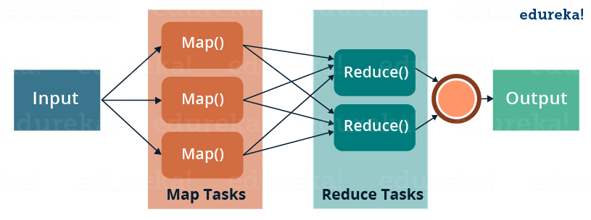
MAPREDUCE FRAMEWORK

Slide 13
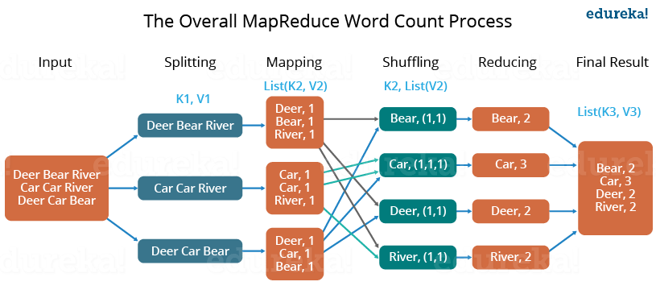
WORDCOUNT MAPREDUCE

Slide 14
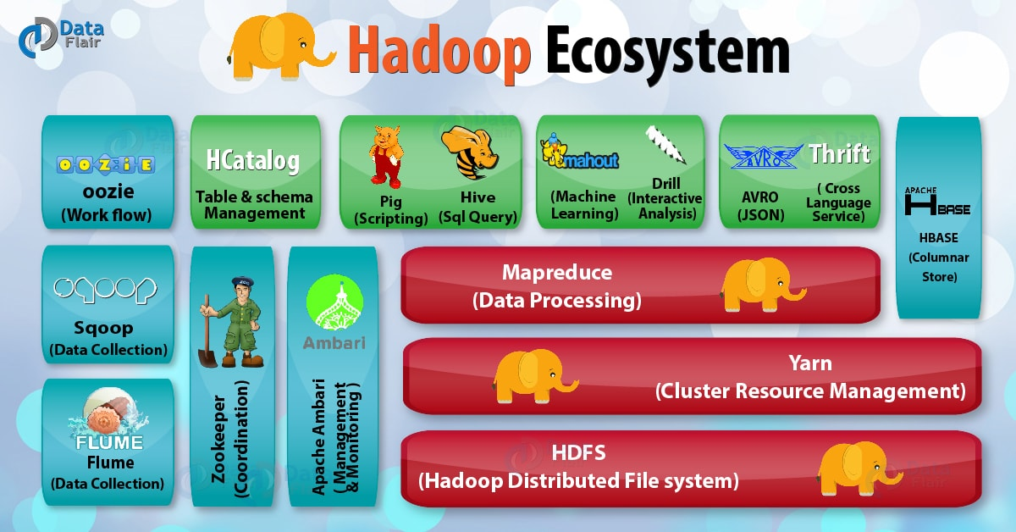
THE HADOOP ECOSYSTEM

Slide 15
CONCLUSION
Big Data is growing rapidly as never before.
Big data is important as orgnizations can mine meaningful insights from this big data for their business.
To cater this increasing demand of storage and computation frameworks like hadoop are essential.
Hadoop stores and processes big data efficiently and with faster execution time and also provides robust fault tolerence.

Slide 16
THANK YOU !

